Slide 1
CHANCELLOR’S REPORT

Slide 2
RAISING VISIBILITY

Slide 3
BOARD OF CURATORS

Slide 4
BOC REPORT AT CHANCELLOR.MST.EDUI

Slide 5
NOW AT CHANCELLOR.MST.EDU

Slide 6
REMINDERS

Slide 7
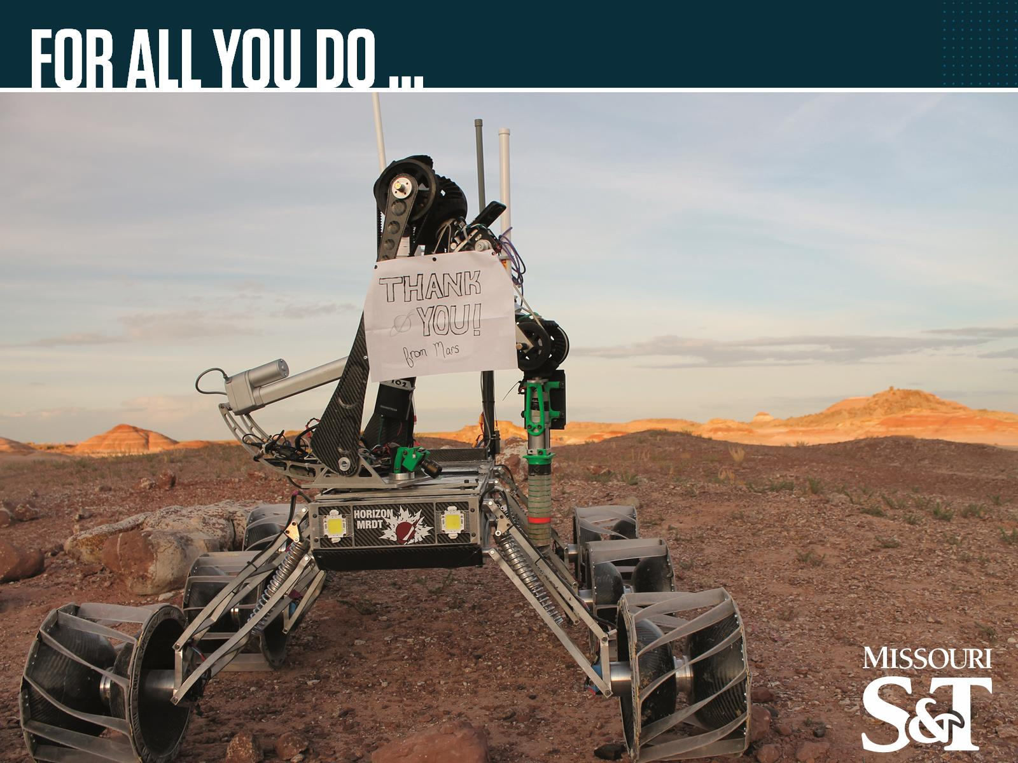
FOR ALL YOU DO …

